Slide 1
Create an entire ETL process in a database and a POWER BI dashboard to utilize Customer Data and achieve below goals:
1. Analyze Customer Data at below levels a) Demographic b) Geographic c) Payment & Account info d) Services
2. Study Churner Profile & Identify areas for implementing marketing campaigns
3. Identify a Method to Predict Future Churners
Metrics Required
1) Total Customers
2) Total Churn & Churn Rate
3) New Joiners
PROJECT GOALS

Slide 2
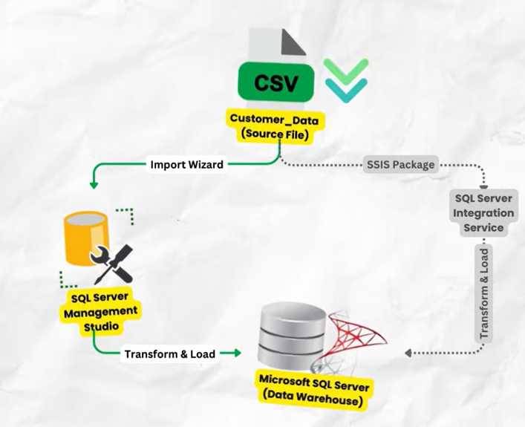
ETL FRAMEWORK

Slide 3
Our framework uses below components:
CSV File – This is our source file
SQL Server Management Studio – We will use its inbuilt import wizard to transform & load the data
SQL Server Database – This is where our final data will be loaded and host our data warehouse, tables & views for final usage.
Alternative Framework:
CSV File – This is our source file
SQL Server Integration Services – We can use custom made SSIS package to transform & load data. This is usually used when you have recurring data loads and you want to automate the process.
SQL Server Database – Package loads our final data into the data warehouse in SQL Server
Components

Slide 4
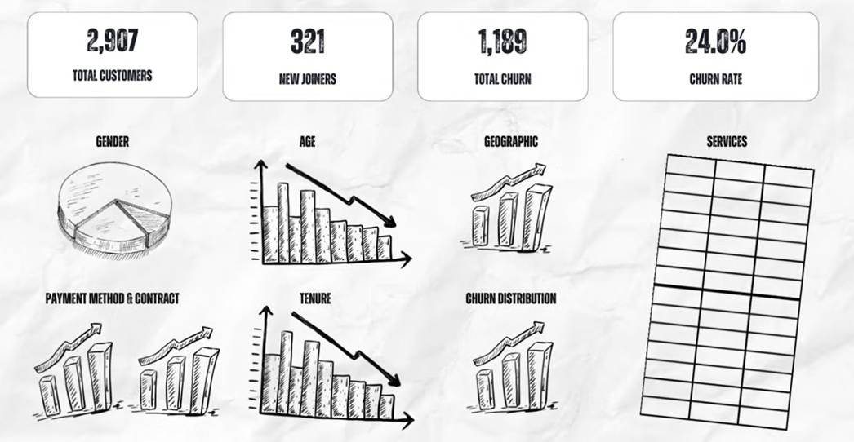
Churn Analysis Dashboard - Blueprint

Slide 5
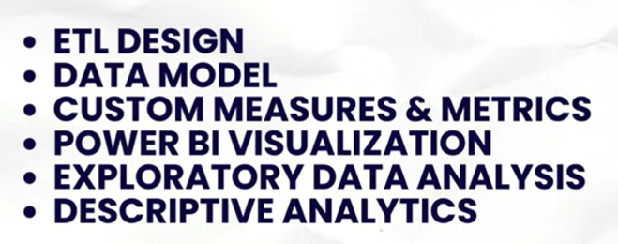
Next Steps……..

Slide 6
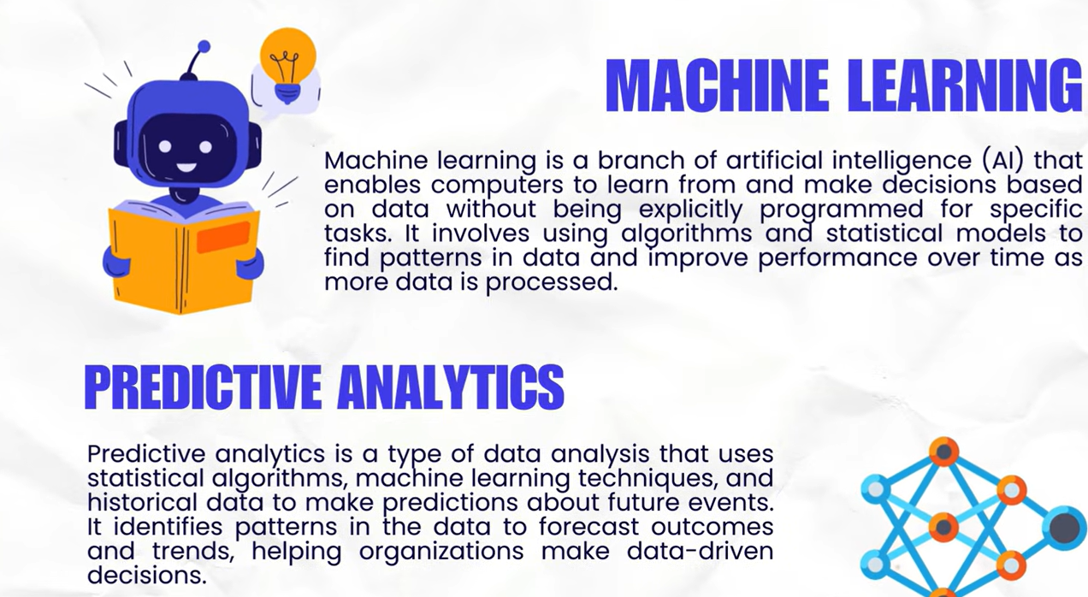
Next Steps……..

Slide 7
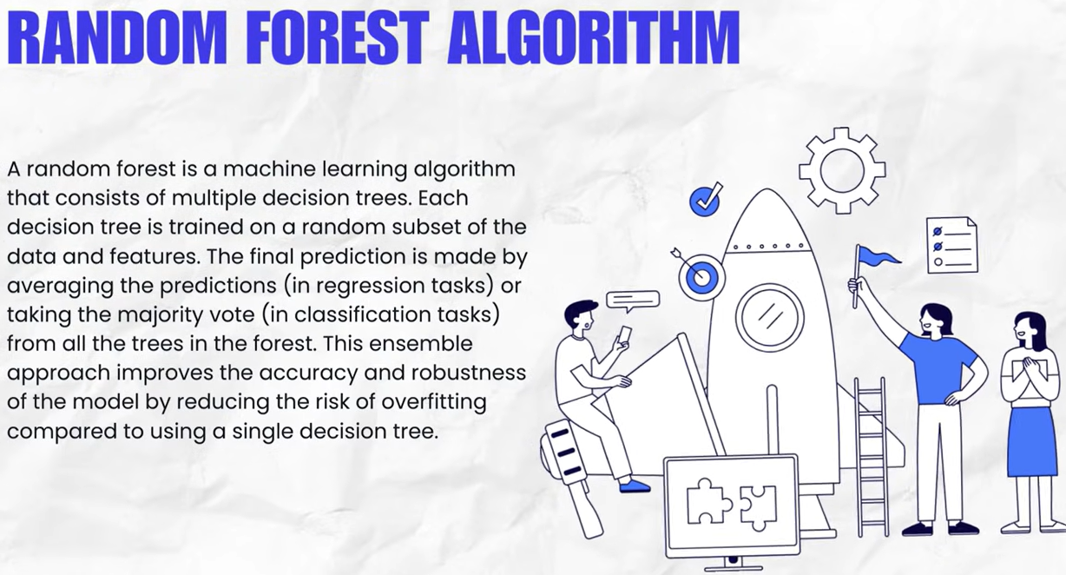
Machine Learning

Slide 8

Machine Learning

